Slide 1


Slide 2

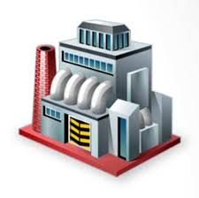


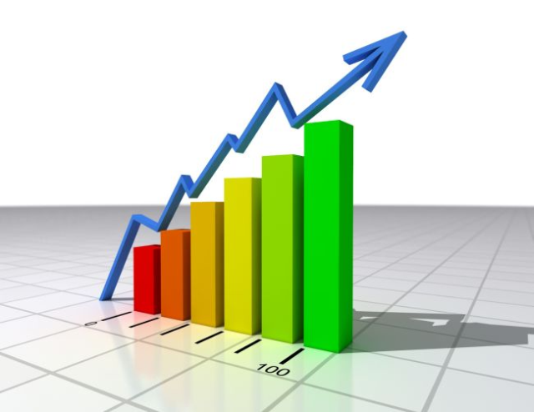
Who we are?
The member of the professional recyclers associations
Own production facility for waste disposal, without accommodation in landfills
Successful audit of leading foreign companies, that work on production technologies for recycling ( Nestle , L / Oréal , Diadzheo... )
New technologies of environmentally safe and non-waste recycling to obtain the product (for cement additives, artificial soil, etc.)

Slide 3
What do we offer?
Disposal of waste 1-4 classes of danger
Product recycling
Collection and removal of waste
Neutralization of waste
Disposal of liquid waste

Slide 4
Technological process
Using waste to produce products
Waste-free recycling
Savings of resources
Environmental safety
Saving of natural resources

Slide 5
The production
facility
Non-stop training of personnel
Video of utilisation process
Mechanized vehicles unloading
Unloading of illiquid products
Comminution
Waste-free recycling
  Using a crane and a forklift trucks
  Simultaneous waste weighing on the hydraulic trolley ROHLA with weights
  With the loss of trade dress
  With the receipt of the certified products

Slide 6
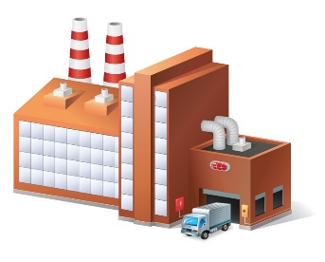



New recycling
technologies
Using waste to produce additives for cement production
Using waste to produce alternative fuels
Using of precipitation of treatment facilities and other waste to produce artificial soil
New recycling technology using electromagnetic devices of fluidized bed

Slide 7
Complex
environmental support
Waste disposal (1-4 classes of danger)
Recycling of illiquid products
Removal and disposal of liquid waste
No disposal at landfills
Disposal of household waste
Development of new technologies for the production of products from waste and methods of recovery of valuable components from waste
Removal and disposal of soil, contaminated with hazardous substances
Development and approval of ecological documentation (passports of waste, materials to obtain licenses)

Slide 8
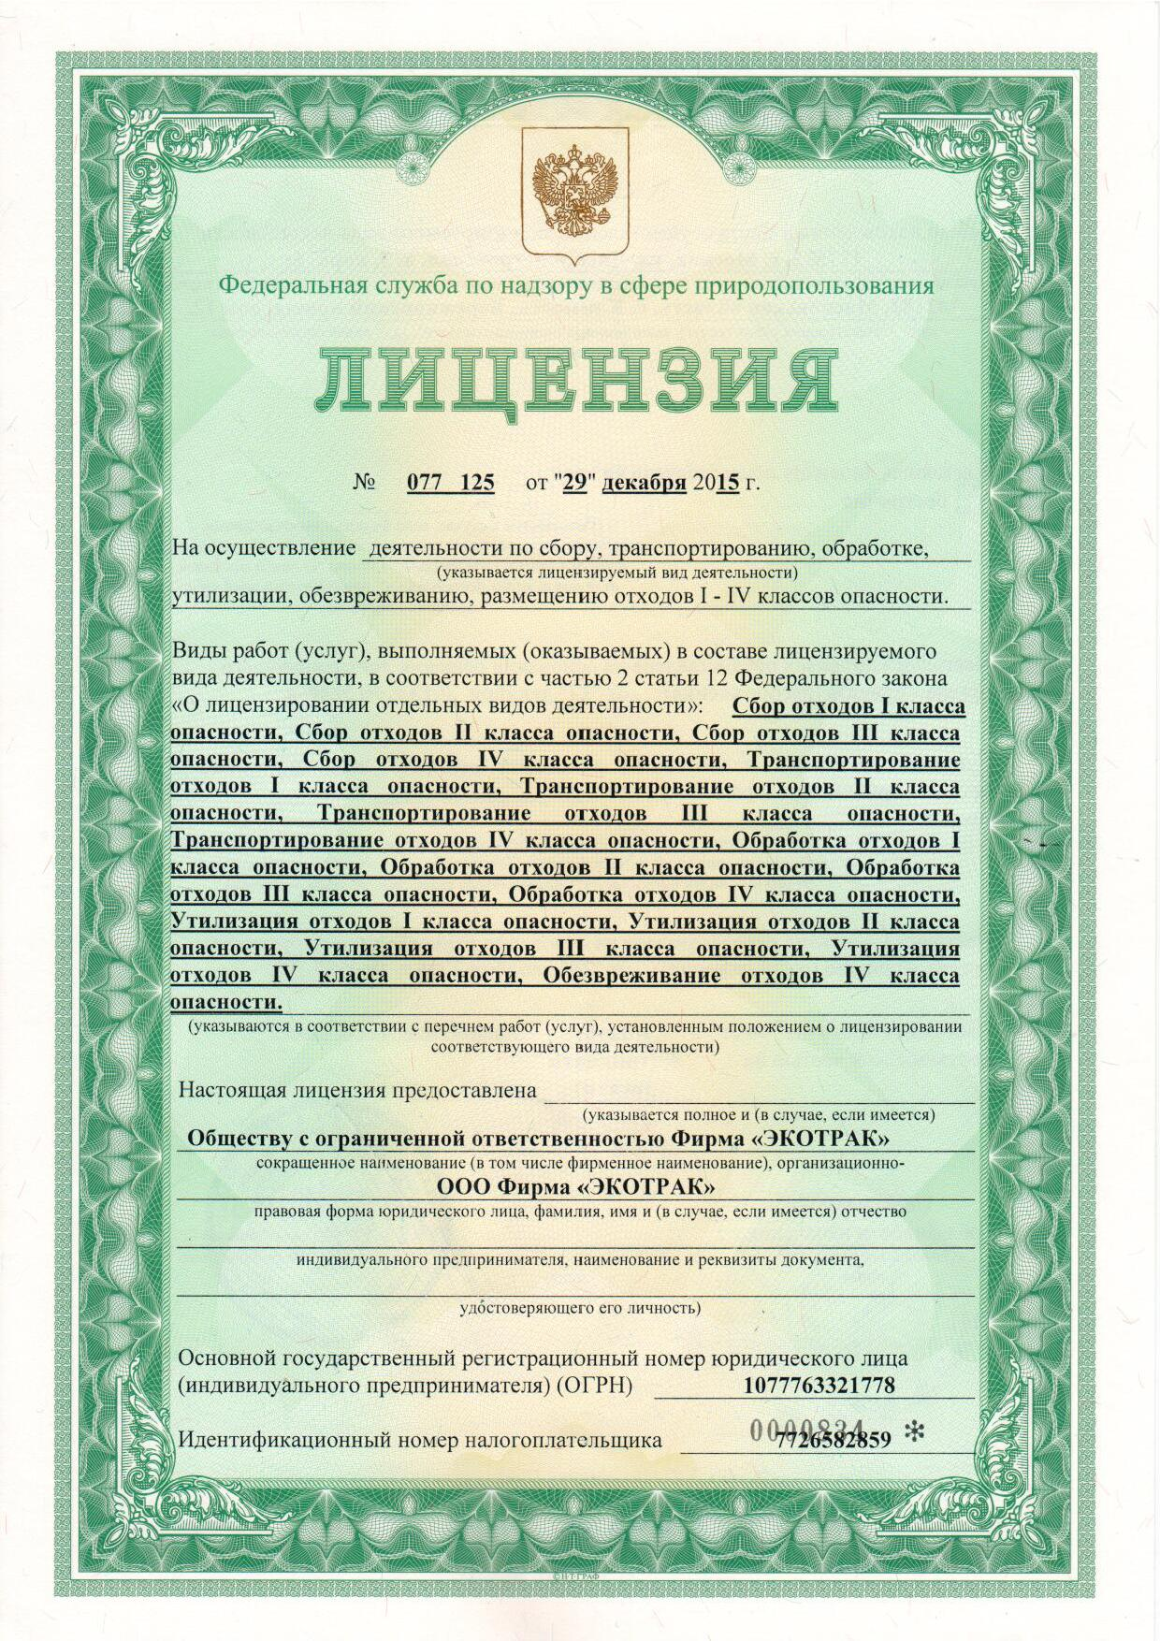
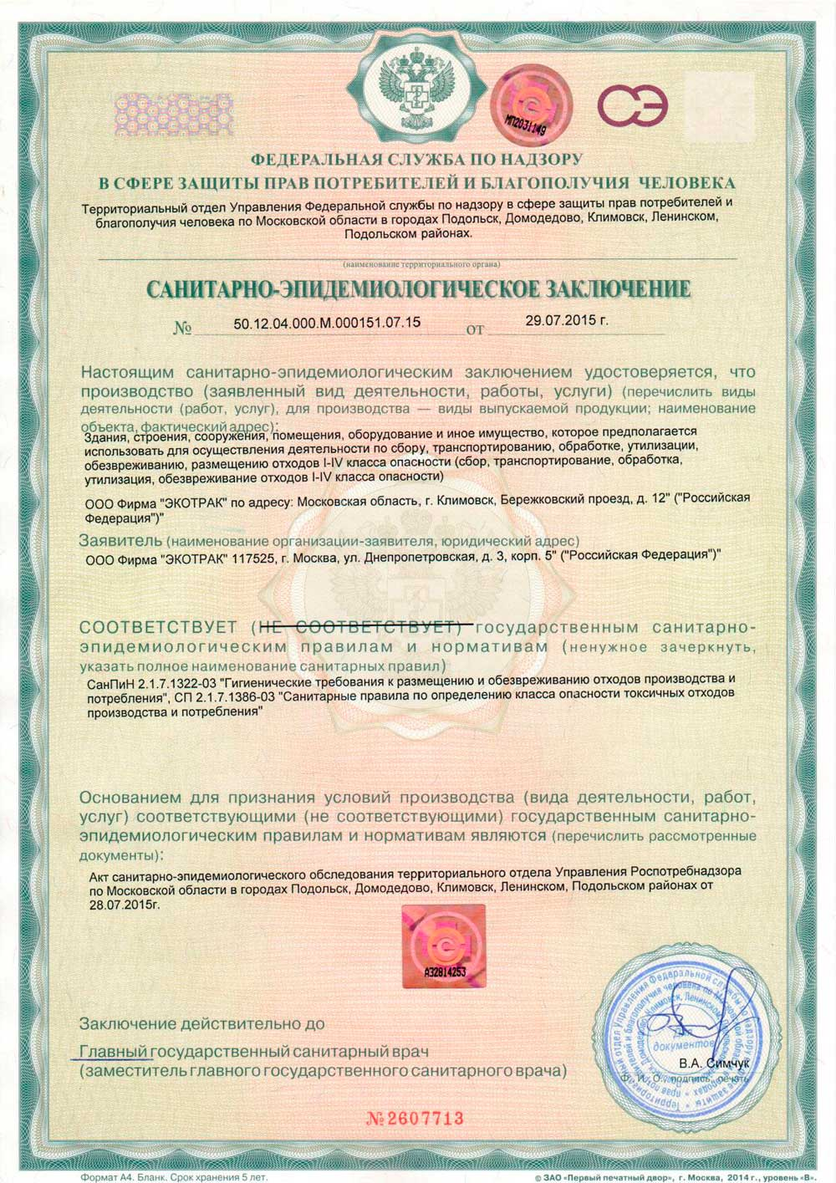
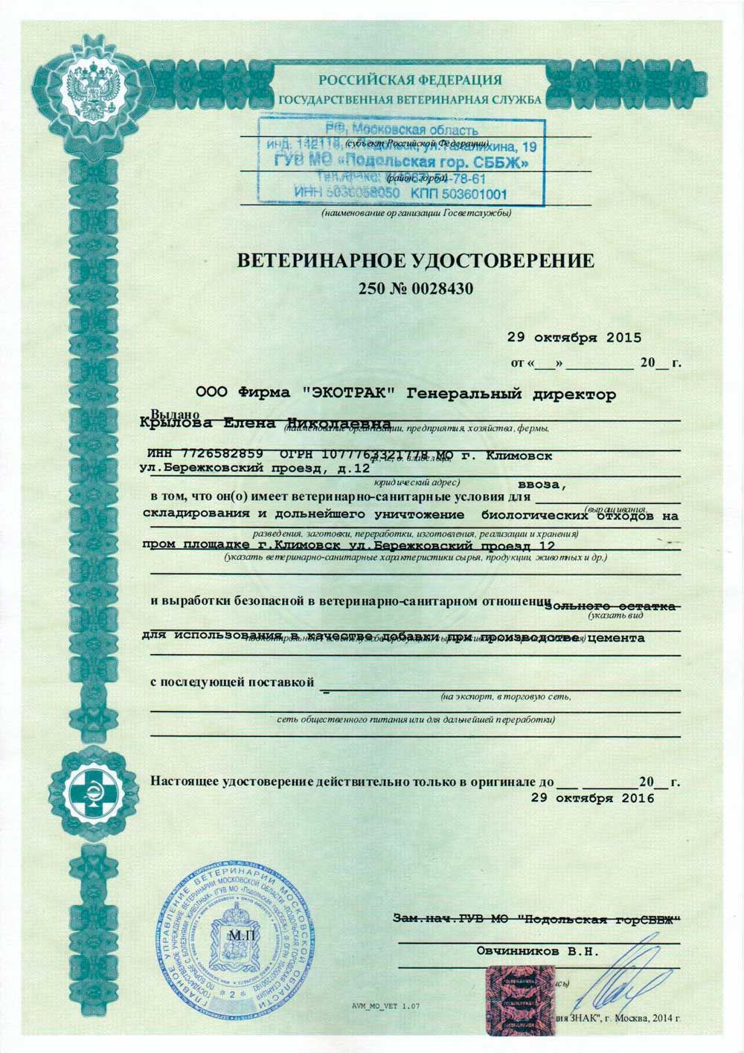
Permission
documentation
License
Sanitary-epidemiological conclusion
Veterinary certificate
On the implementation of the activities for the collection, transportation, treatment, recycling and neutralization of waste 1-4 classes of danger
On disposal of biological waste

Slide 9
Our
advantages
Lack of environmental payments
Highly qualified staff
wastelessness
Unique recycling technology
Environmentally friendly
Waste are not placed in landfills

Slide 10
Our publications
and articles
"The possibility of resource-saving utilization of illiquid products." Journal "Industrial ecology" 2016. №7
"Safe disposal of food waste." The magazine "Food Industry" 2016 №2
"Environmentally safe disposal of food waste products," Journal "Pischepromekspert" 2016. №31
"New technology of waste disposal" material from IX International scientific and practical conference "Recycling, waste recycling and clean technologies" 2013.

Slide 11
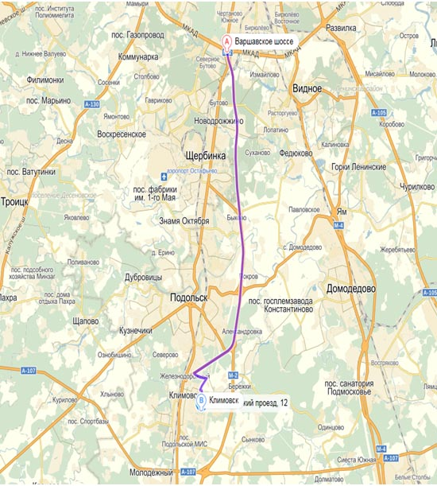
Contact
information
Contacts
  Tel .: +7 (499) 557-01-72
  Tel .: +7 (499) 557-01-84
  Fax: +7 (499) 557-01-19
Address:
  Moscow region, Podolsky district, Klimovsk, Zavodskaya St., 2
Navigator:
  Moscow region, Podolsky district, Klimovsk, Zavodskaya St., 2
At the checkpoint you shall call on the numbers above

